Slide 1

Tracing
Chris Piech
CS106A, Stanford University
This is Method Man. He is part of the Wu Tang Clan. ☺

Slide 2

Learn How To:
Trace programs step by step

Slide 3
Anatomy of a method
public void run() {
double mid = average(5.0, 10.2);
println(mid);
}
private double average(double a, double b) {
double sum = a + b;
return sum / 2;
}

Slide 4
Anatomy of a method
public void run() {
double mid = average(5.0, 10.2);
println(mid);
}
private double average(double a, double b) {
double sum = a + b;
return sum / 2;
}
method “definition”

Slide 5
Anatomy of a method
public void run() {
double mid = average(5.0, 10.2);
println(mid);
}
private double average(double a, double b) {
double sum = a + b;
return sum / 2;
}
Output expected
Input expected

Slide 6
Anatomy of a method
public void run() {
double mid = average(5.0, 10.2);
println(mid);
}
private double average(double a, double b) {
double sum = a + b;
return sum / 2;
}
Return Type
Parameters

Slide 7
Anatomy of a method
public void run() {
double mid = average(5.0, 10.2);
println(mid);
}
private double average(double a, double b) {
double sum = a + b;
return sum / 2;
}
name

Slide 8
Anatomy of a method
public void run() {
double mid = average(5.0, 10.2);
println(mid);
}
private double average(double a, double b) {
double sum = a + b;
return sum / 2;
}
body

Slide 9
Anatomy of a method
public void run() {
double mid = average(5.0, 10.2);
println(mid);
}
private double average(double a, double b) {
double sum = a + b;
return sum / 2;
}
Ends the method and gives
back a single value

Slide 10
Anatomy of a method
public void run() {
double mid = average(5.0, 10.2);
println(mid);
}
private double average(double a, double b) {
double sum = a + b;
return sum / 2;
}
This statement is necessary because average promised to return a double

Slide 11
Anatomy of a method
public void run() {
double mid = average(5.0, 10.2);
println(mid);
}
private double average(double a, double b) {
double sum = a + b;
return sum / 2;
}
method “call”

Slide 12
Anatomy of a method
public void run() {
double mid = average(5.0, 10.2);
println(mid);
}
private double average(double a, double b) {
double sum = a + b;
return sum / 2;
}
arguments

Slide 13
Anatomy of a method
Return Type
Parameters
public void run() {
double mid = average(5.0, 10.2);
println(mid);
}
private double average(double a, double b) {
double sum = a + b;
return sum / 2;
}

Slide 14
Anatomy of a method
public void run() {
double mid = average(5.0, 10.2);
println(mid);
}
private double average(double a, double b) {
double sum = a + b;
return sum / 2;
}
When a method ends it “returns”

Slide 15
Trace
public void run() {
double mid = average(5.0, 10.2);
println(mid);
}
private double average(double a, double b) {
double sum = a + b;
return sum / 2;
}

Slide 16
Trace
Run memory
No variables
public void run() {
double mid = average(5.0, 10.2);
println(mid);
}
private double average(double a, double b) {
double sum = a + b;
return sum / 2;
}

Slide 17
Trace
Run memory
No variables
public void run() {
double mid = average(5.0, 10.2);
println(mid);
}
private double average(double a, double b) {
double sum = a + b;
return sum / 2;
}

Slide 18
Trace
Run memory
No variables
public void run() {
double mid = average(5.0, 10.2);
println(mid);
}
private double average(double a, double b) {
double sum = a + b;
return sum / 2;
}

Slide 19
Trace
Run memory
No variables
public void run() {
double mid = average(5.0, 10.2);
println(mid);
}
private double average(double a, double b) {
double sum = a + b;
return sum / 2;
}

Slide 20
Trace
Run memory
average memory
No variables
a
b
public void run() {
double mid = average(5.0, 10.2);
println(mid);
}
private double average(double a, double b) {
double sum = a + b;
return sum / 2;
}

Slide 21
Trace
Run memory
average memory
a
5.0
b
10.2
No variables
public void run() {
double mid = average(5.0, 10.2);
println(mid);
}
private double average(double a, double b) {
double sum = a + b;
return sum / 2;
}

Slide 22
Trace
Run memory
average memory
a
5.0
b
10.2
No variables
public void run() {
double mid = average(5.0, 10.2);
println(mid);
}
private double average(double a, double b) {
double sum = a + b;
return sum / 2;
}

Slide 23
Trace
Run memory
average memory
a
5.0
b
10.2
sum
15.2
No variables
public void run() {
double mid = average(5.0, 10.2);
println(mid);
}
private double average(double a, double b) {
double sum = a + b;
return sum / 2;
}

Slide 24
Trace
Run memory
average memory
a
5.0
b
10.2
sum
15.2
No variables
public void run() {
double mid = average(5.0, 10.2);
println(mid);
}
private double average(double a, double b) {
double sum = a + b;
return sum / 2;
}
7.6

Slide 25
Trace
Run memory
average memory
a
5.0
b
10.2
sum
15.2
No variables
public void run() {
double mid = average(5.0, 10.2);
println(mid);
}
private double average(double a, double b) {
double sum = a + b;
return sum / 2;
}
7.6

Slide 26
Trace
Run memory
No variables
public void run() {
double mid = average(5.0, 10.2);
println(mid);
}
private double average(double a, double b) {
double sum = a + b;
return sum / 2;
}
7.6

Slide 27
Trace
Run memory
mid
7.6
public void run() {
double mid = average(5.0, 10.2);
println(mid);
}
private double average(double a, double b) {
double sum = a + b;
return sum / 2;
}

Slide 28
Trace
Run memory
mid
7.6
public void run() {
double mid = average(5.0, 10.2);
println(mid);
}
private double average(double a, double b) {
double sum = a + b;
return sum / 2;
}

Slide 29
Trace
Run memory
mid
7.6
public void run() {
double mid = average(5.0, 10.2);
println(mid);
}
private double average(double a, double b) {
double sum = a + b;
return sum / 2;
}

Slide 30
Trace
public void run() {
double mid = average(5.0, 10.2);
println(mid);
}
private double average(double a, double b) {
double sum = a + b;
return sum / 2;
}

Slide 31
Drawing Flags

Slide 32
Flags
private void drawColombiasFlag() {
// Call drawStripe three times
// with different inputs each time
drawStripe(Color.YELLOW, 0); drawStripe(Color.BLUE, 0.5); drawStripe(Color.RED, 0.75);
}
// Define drawStripe
// drawStripe needs two inputs (which come as variables)
// First a color, then a fraction down the screen
private void drawStripe(Color color, double fractionDown) {
double y = getHeight() * fractionDown;
GRect rect = new GRect(0, y, getWidth(), getHeight() - y);
rect.setColor(color);
rect.setFilled(true);
add(rect);
}
method “definition”

Slide 33
Flags
private void drawColombiasFlag() {
// Call drawStripe three times
// with different inputs each time
drawStripe(Color.YELLOW, 0); drawStripe(Color.BLUE, 0.5); drawStripe(Color.RED, 0.75);
}
// Define drawStripe
// drawStripe needs two inputs (which come as variables)
// First a color, then a fraction down the screen
private void drawStripe(Color color, double fractionDown) {
double y = getHeight() * fractionDown;
GRect rect = new GRect(0, y, getWidth(), getHeight() - y);
rect.setColor(color);
rect.setFilled(true);
add(rect);
}
Takes two inputs: (1) a color, (2) a fraction

Slide 34
Flags
private void drawColombiasFlag() {
// Call drawStripe three times
// with different inputs each time
drawStripe(Color.YELLOW, 0); drawStripe(Color.BLUE, 0.5); drawStripe(Color.RED, 0.75);
}
Thus, every time the method is called, two inputs must be given!
// Define drawStripe
// drawStripe needs two inputs (which come as variables)
// First a color, then a fraction down the screen
private void drawStripe(Color color, double fractionDown) {
double y = getHeight() * fractionDown;
GRect rect = new GRect(0, y, getWidth(), getHeight() - y);
rect.setColor(color);
rect.setFilled(true);
add(rect);
}

Slide 35
Flags
private void drawColombiasFlag() {
// Call drawStripe three times
// with different inputs each time
drawStripe(Color.YELLOW, 0); drawStripe(Color.BLUE, 0.5); drawStripe(Color.RED, 0.75);
}
The method receives the first input in a box (aka as a variable), with the name color
// Define drawStripe
// drawStripe needs two inputs (which come as variables)
// First a color, then a fraction down the screen
private void drawStripe(Color color, double fractionDown) {
double y = getHeight() * fractionDown;
GRect rect = new GRect(0, y, getWidth(), getHeight() - y);
rect.setColor(color);
rect.setFilled(true);
add(rect);
}
It can use the value in the color variable

Slide 36
Flags
private void drawColombiasFlag() {
// Call drawStripe three times
// with different inputs each time
drawStripe(Color.YELLOW, 0); drawStripe(Color.BLUE, 0.5); drawStripe(Color.RED, 0.75);
}
The method receives the second input in a box (aka as a variable), with the name fractionDown
// Define drawStripe
// drawStripe needs two inputs (which come as variables)
// First a color, then a fraction down the screen
private void drawStripe(Color color, double fractionDown) {
double y = getHeight() * fractionDown;
GRect rect = new GRect(0, y, getWidth(), getHeight() - y);
rect.setColor(color);
rect.setFilled(true);
add(rect);
}
It can use the value in the fractionDown variable

Slide 37
A Full Program
public class FactorialExample extends ConsoleProgram {
private static final int MAX_NUM = 4;
public void run() {
for(int i = 0; i < MAX_NUM; i++) {
println(i + "! = " + factorial(i));
}
}
private int factorial(int n) {
int result = 1;
for (int i = 1; i <= n; i++) {
result *= i;
}
return result;
}
}

Slide 38
A Full Program
public class FactorialExample extends ConsoleProgram {
private static final int MAX_NUM = 4;
public void run() {
for(int i = 0; i < MAX_NUM; i++) {
println(i + "! = " + factorial(i));
}
}
private int factorial(int n) {
int result = 1;
for (int i = 1; i <= n; i++) {
result *= i;
}
return result;
}
}

Slide 39
Understand the Mechanism

Slide 40
public void run() {
for(int i = 0; i < MAX_NUM; i++) {
println(i + "! = " + factorial(i));
}
}
i

Slide 41
public void run() {
for(int i = 0; i < MAX_NUM; i++) {
println(i + "! = " + factorial(i));
}
}
i
0

Slide 42
public void run() {
for(int i = 0; i < MAX_NUM; i++) {
println(i + "! = " + factorial(i));
}
}
i
0

Slide 43
public void run() {
for(int i = 0; i < MAX_NUM; i++) {
println(i + "! = " + factorial(i));
}
}
i
0

Slide 44
public void run() {
for(int i = 0; i < MAX_NUM; i++) {
println(i + "! = " + factorial(i));
}
}
i
0

Slide 45
public void run() {
for(int i = 0; i < MAX_NUM; i++) {
println(i + "! = " + factorial(i));
}
}
private int factorial(int n) {
int result = 1;
for (int i = 1; i <= n; i++) {
result *= i;
}
return result;
}
0
i
n
0
result
i

Slide 46
public void run() {
for(int i = 0; i < MAX_NUM; i++) {
println(i + "! = " + factorial(i));
}
}
private int factorial(int n) {
int result = 1;
for (int i = 1; i <= n; i++) {
result *= i;
}
return result;
}
0
i
n
0
1
result
i

Slide 47
public void run() {
for(int i = 0; i < MAX_NUM; i++) {
println(i + "! = " + factorial(i));
}
}
private int factorial(int n) {
int result = 1;
for (int i = 1; i <= n; i++) {
result *= i;
}
return result;
}
0
i
n
0
1
1
result
i

Slide 48
public void run() {
for(int i = 0; i < MAX_NUM; i++) {
println(i + "! = " + factorial(i));
}
}
private int factorial(int n) {
int result = 1;
for (int i = 1; i <= n; i++) {
result *= i;
}
return result;
}
0
i
n
0
1
1
result
i

Slide 49
public void run() {
for(int i = 0; i < MAX_NUM; i++) {
println(i + "! = " + factorial(i));
}
}
private int factorial(int n) {
int result = 1;
for (int i = 1; i <= n; i++) {
result *= i;
}
return result;
}
0
i
n
0
1
1
result
i

Slide 50
public void run() {
for(int i = 0; i < MAX_NUM; i++) {
println(i + "! = " + factorial(i));
}
}
1
i
0

Slide 51
public void run() {
for(int i = 0; i < MAX_NUM; i++) {
println(i + "! = " + factorial(i));
}
}
1
i
0
0! = 1

Slide 52
public void run() {
for(int i = 0; i < MAX_NUM; i++) {
println(i + "! = " + factorial(i));
}
}
i
1
0! = 1

Slide 53
public void run() {
for(int i = 0; i < MAX_NUM; i++) {
println(i + "! = " + factorial(i));
}
}
i
1
0! = 1

Slide 54
public void run() {
for(int i = 0; i < MAX_NUM; i++) {
println(i + "! = " + factorial(i));
}
}
i
1
0! = 1

Slide 55
public void run() {
for(int i = 0; i < MAX_NUM; i++) {
println(i + "! = " + factorial(i));
}
}
i
1
0! = 1

Slide 56
public void run() {
for(int i = 0; i < MAX_NUM; i++) {
println(i + "! = " + factorial(i));
}
}
private int factorial(int n) {
int result = 1;
for (int i = 1; i <= n; i++) {
result *= i;
}
return result;
}
0
i
n
1
result
i
0! = 1

Slide 57
public void run() {
for(int i = 0; i < MAX_NUM; i++) {
println(i + "! = " + factorial(i));
}
}
private int factorial(int n) {
int result = 1;
for (int i = 1; i <= n; i++) {
result *= i;
}
return result;
}
0
i
n
1
1
result
i
0! = 1

Slide 58
public void run() {
for(int i = 0; i < MAX_NUM; i++) {
println(i + "! = " + factorial(i));
}
}
private int factorial(int n) {
int result = 1;
for (int i = 1; i <= n; i++) {
result *= i;
}
return result;
}
0
i
n
1
1
1
result
i
0! = 1

Slide 59
public void run() {
for(int i = 0; i < MAX_NUM; i++) {
println(i + "! = " + factorial(i));
}
}
private int factorial(int n) {
int result = 1;
for (int i = 1; i <= n; i++) {
result *= i;
}
return result;
}
0
i
n
1
1
1
result
i
0! = 1

Slide 60
public void run() {
for(int i = 0; i < MAX_NUM; i++) {
println(i + "! = " + factorial(i));
}
}
private int factorial(int n) {
int result = 1;
for (int i = 1; i <= n; i++) {
result *= i;
}
return result;
}
0
i
n
1
1
1
result
i
0! = 1

Slide 61
public void run() {
for(int i = 0; i < MAX_NUM; i++) {
println(i + "! = " + factorial(i));
}
}
private int factorial(int n) {
int result = 1;
for (int i = 1; i <= n; i++) {
result *= i;
}
return result;
}
0
i
n
1
1
2
result
i
0! = 1

Slide 62
public void run() {
for(int i = 0; i < MAX_NUM; i++) {
println(i + "! = " + factorial(i));
}
}
private int factorial(int n) {
int result = 1;
for (int i = 1; i <= n; i++) {
result *= i;
}
return result;
}
0
i
n
1
1
2
result
i
0! = 1

Slide 63
public void run() {
for(int i = 0; i < MAX_NUM; i++) {
println(i + "! = " + factorial(i));
}
}
private int factorial(int n) {
int result = 1;
for (int i = 1; i <= n; i++) {
result *= i;
}
return result;
}
0
i
n
1
1
2
result
i
0! = 1

Slide 64
public void run() {
for(int i = 0; i < MAX_NUM; i++) {
println(i + "! = " + factorial(i));
}
}
1
i
1
0! = 1

Slide 65
public void run() {
for(int i = 0; i < MAX_NUM; i++) {
println(i + "! = " + factorial(i));
}
}
1
i
1
0! = 1
1! = 1

Slide 66
public void run() {
for(int i = 0; i < MAX_NUM; i++) {
println(i + "! = " + factorial(i));
}
}
i
2
0! = 1
1! = 1

Slide 67
public void run() {
for(int i = 0; i < MAX_NUM; i++) {
println(i + "! = " + factorial(i));
}
}
i
2
0! = 1
1! = 1

Slide 68
public void run() {
for(int i = 0; i < MAX_NUM; i++) {
println(i + "! = " + factorial(i));
}
}
i
2
0! = 1
1! = 1

Slide 69
public void run() {
for(int i = 0; i < MAX_NUM; i++) {
println(i + "! = " + factorial(i));
}
}
i
2
0! = 1
1! = 1

Slide 70
public void run() {
for(int i = 0; i < MAX_NUM; i++) {
println(i + "! = " + factorial(i));
}
}
2
i
2
0! = 1
1! = 1

Slide 71
public void run() {
for(int i = 0; i < MAX_NUM; i++) {
println(i + "! = " + factorial(i));
}
}
2
i
2
0! = 1
1! = 1
2! = 2

Slide 72
public void run() {
for(int i = 0; i < MAX_NUM; i++) {
println(i + "! = " + factorial(i));
}
}
i
3
0! = 1
1! = 1
2! = 2

Slide 73
public void run() {
for(int i = 0; i < MAX_NUM; i++) {
println(i + "! = " + factorial(i));
}
}
i
3
0! = 1
1! = 1
2! = 2

Slide 74
public void run() {
for(int i = 0; i < MAX_NUM; i++) {
println(i + "! = " + factorial(i));
}
}
i
3
0! = 1
1! = 1
2! = 2

Slide 75
public void run() {
for(int i = 0; i < MAX_NUM; i++) {
println(i + "! = " + factorial(i));
}
}
i
3
0! = 1
1! = 1
2! = 2

Slide 76
public void run() {
for(int i = 0; i < MAX_NUM; i++) {
println(i + "! = " + factorial(i));
}
}
6
i
3
0! = 1
1! = 1
2! = 2

Slide 77
public void run() {
for(int i = 0; i < MAX_NUM; i++) {
println(i + "! = " + factorial(i));
}
}
6
i
3
0! = 1
1! = 1
2! = 2
3! = 6

Slide 78
public void run() {
for(int i = 0; i < MAX_NUM; i++) {
println(i + "! = " + factorial(i));
}
}
i
4
0! = 1
1! = 1
2! = 2
3! = 6

Slide 79
public void run() {
for(int i = 0; i < MAX_NUM; i++) {
println(i + "! = " + factorial(i));
}
}
i
4
0! = 1
1! = 1
2! = 2
3! = 6

Slide 80

Parameters
Every time a method is called, new memory is created for the call.

Slide 81
Bad Times With Methods
// NOTE: This program is buggy!!
private void addFive(int x) {
x += 5;
}
public void run() {
int x = 3;
addFive(x);
println("x = " + x);
}
Let’s “trace” this program on the board

Slide 82
Good Times With Methods
// NOTE: This program is feeling just fine...
private int addFive(int x) {
x += 5;
return x;
}
public void run() {
int x = 3;
x = addFive(x);
println("x = " + x);
}

Slide 83
For primitives: Variables are not passed when you use parameters. Values are passed

Slide 84
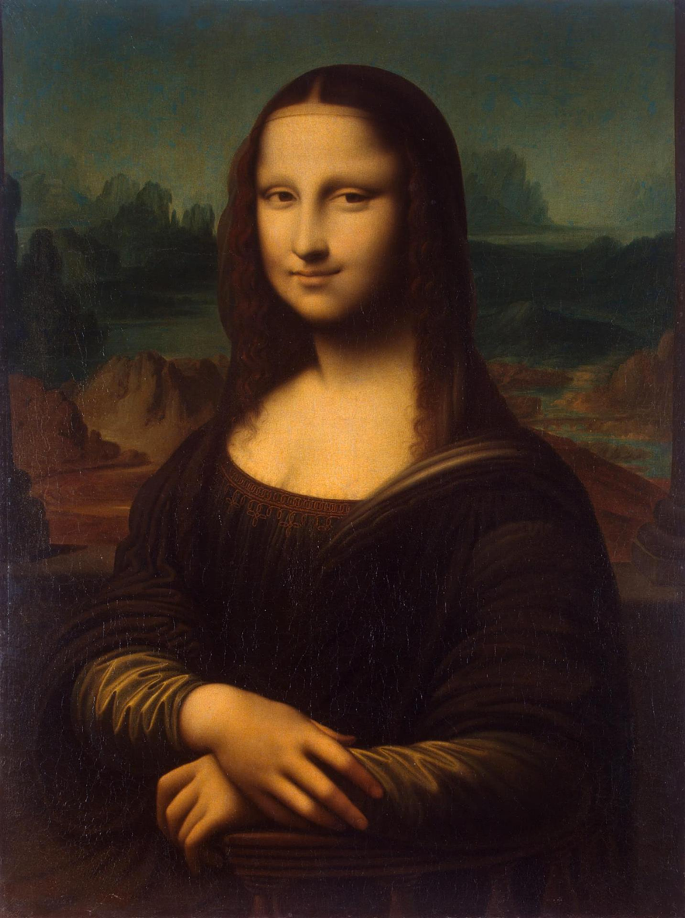
Pass by “Value”
- Thanks Mehran

Slide 85
More Examples

Slide 86
Changed Name
private void run() {
int num = 5;
cow(num);
}
private void cow(int grass) {
println(grass);
}

Slide 87
Changed Name
Run memory
private void run() {
int num = 5;
cow(num);
}
private void cow(int grass) {
println(grass);
}
num
5

Slide 88
Changed Name
Run memory
private void run() {
int num = 5;
cow(num);
}
private void cow(int grass) {
println(grass);
}
num
5

Slide 89
Changed Name
Run memory
private void run() {
int num = 5;
cow(num);
}
private void cow(int grass) {
println(grass);
}
num
5

Slide 90
Changed Name
Run memory
Cow memory
private void run() {
int num = 5;
cow(num);
}
private void cow(int grass) {
println(grass);
}
num
5
grass

Slide 91
Changed Name
Run memory
Cow memory
private void run() {
int num = 5;
cow(num);
}
private void cow(int grass) {
println(grass);
}
num
5
grass
5

Slide 92
Changed Name
Run memory
Cow memory
private void run() {
int num = 5;
cow(num);
}
private void cow(int grass) {
println(grass);
}
num
5
grass
5

Slide 93
Changed Name
Run memory
Cow memory
private void run() {
int num = 5;
cow(num);
}
private void cow(int grass) {
println(grass);
}
num
5
grass
5

Slide 94
Changed Name
Run memory
private void run() {
int num = 5;
cow(num);
}
private void cow(int grass) {
println(grass);
}
num
5

Slide 95
Changed Name
Run memory
private void run() {
int num = 5;
cow(num);
}
private void cow(int grass) {
println(grass);
}
num
5

Slide 96
Changed Name
private void run() {
int num = 5;
cow(num);
}
private void cow(int grass) {
println(grass);
}

Slide 98
Same Variable Name
private void run() {
int money = 5;
retireEarly();
println(money);
}
private void retireEarly(){
int money = 1200000;
println(money);
}

Slide 99
Same Variable Name
run
private void run() {
int money = 5;
retireEarly();
println(money);
}
private void retireEarly(){
int money = 1200000;
println(money);
}
money
5

Slide 100
Same Variable Name
run
private void run() {
int money = 5;
retireEarly();
println(money);
}
private void retireEarly(){
int money = 1200000;
println(money);
}
money
5

Slide 101
Same Variable Name
run
private void run() {
int money = 5;
retireEarly();
println(money);
}
private void retireEarly(){
int money = 1200000;
println(money);
}
money
5
retireEarly

Slide 102
Same Variable Name
run
private void run() {
int money = 5;
retireEarly();
println(money);
}
private void retireEarly(){
int money = 1200000;
println(money);
}
money
5
retireEarly
money
1200000

Slide 103
Same Variable Name
run
private void run() {
int money = 5;
retireEarly();
println(money);
}
private void retireEarly(){
int money = 1200000;
println(money);
}
money
5
retireEarly
money
1200000
1200000

Slide 104
Same Variable Name
run
private void run() {
int money = 5;
retireEarly();
println(money);
}
private void retireEarly(){
int money = 1200000;
println(money);
}
money
5
retireEarly
money
1200000
1200000

Slide 105
Same Variable Name
run
private void run() {
int money = 5;
retireEarly();
println(money);
}
private void retireEarly(){
int money = 1200000;
println(money);
}
money
5
1200000
5

Slide 107

No Methods in Methods
private void run() {
println(“hello world”);
private void sayGoodbye() {
println(“goodbye!”);
}
}
Illegal modifier for parameter goodbye, only final is permitted
Huh?!?

Slide 108
No Methods in Methods
private void run() {
println(“hello world”);
sayGoodbye();
}
private void sayGoodbye() {
println(“goodbye!”);
}

Slide 109
Remember Booleans?

Slide 110
Boolean Variable
boolean karelIsAwesome = true;
boolean myBool = 1 < 2;

Slide 111
Boolean Operations
boolean a = true;
boolean b = false;
boolean and = a && b;
boolean or = a || b;
boolean not = !a;

Slide 112
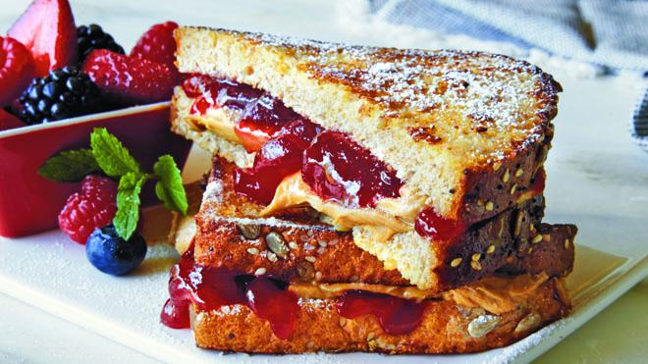

Slide 113
Is Square
public void run() {
for(int i = 1; i <= 100; i++) {
if(isSquare(i)) {
println(i);
}
}
}

Slide 114
Boolean Return
public void run() {
for(int i = 1; i <= 100; i++) {
if(isSquare(i)) {
println(i);
}
}
}
private boolean isSquare(int x) {
double root = Math.sqrt(x);
if(root == Math.floor(root)) {
return true;
} else {
return false;
}
}

Slide 115
Boolean Return
public void run() {
for(int i = 1; i <= 100; i++) {
if(isSquare(i)) {
println(i);
}
}
}
private boolean isSquare(int x) {
double root = Math.sqrt(x);
return root == Math.floor(root);
}

Slide 116
Boolean Return
public void run() {
for(int i = 1; i <= 100; i++) {
if(isSquare(i)) {
println(i);
}
}
}
private boolean isSquare(int x) {
double root = Math.sqrt(x);
return root == (int)root;
}

Slide 117
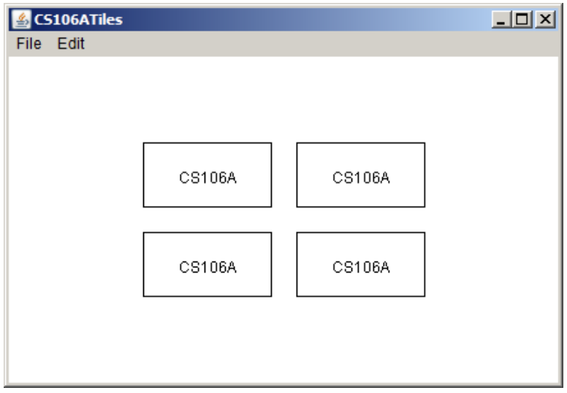
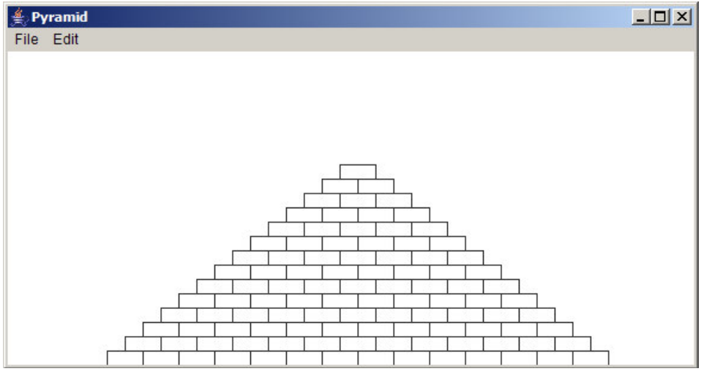
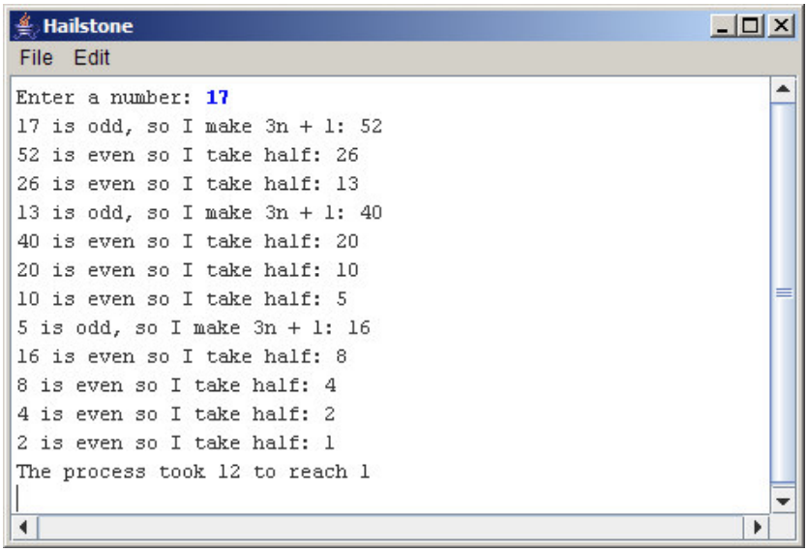

Assn 2
Absolutely
Not necessary
Yes
Odd test?

Slide 119
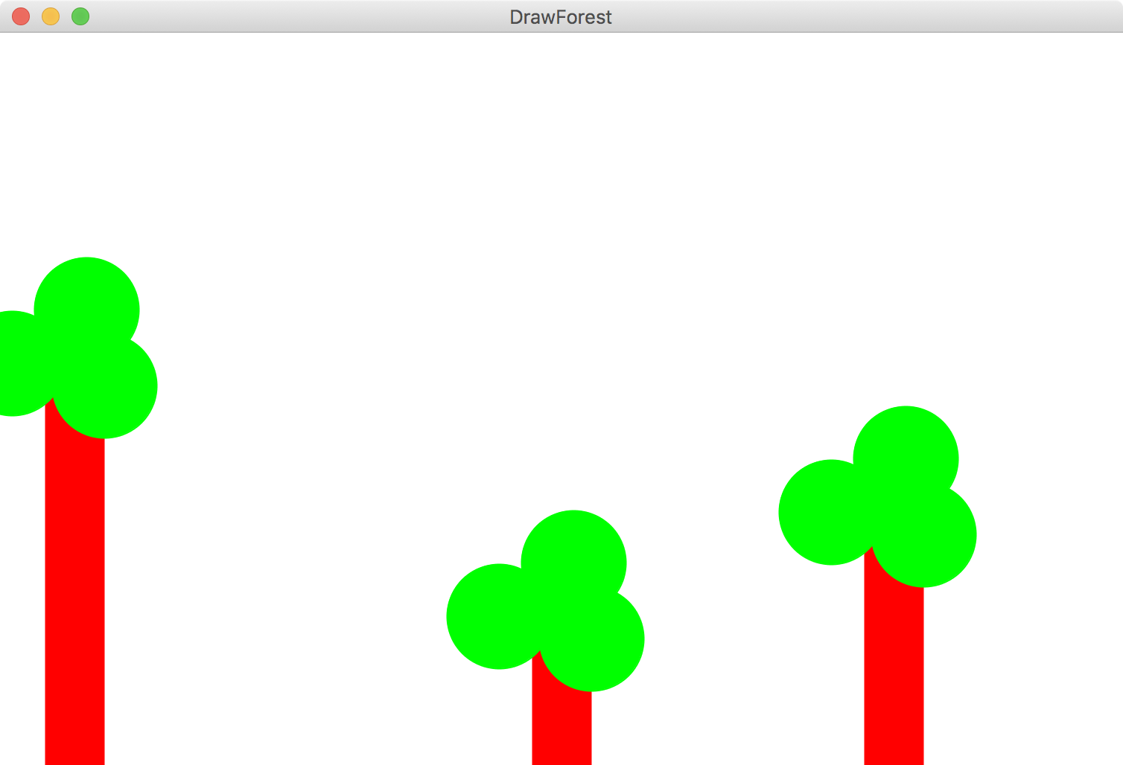

Slide 120
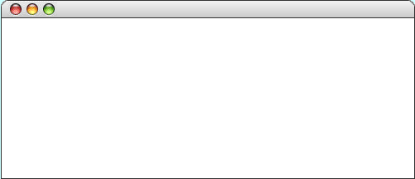
GOval
The GOval class represents an elliptical shape defined by the boundaries of its enclosing rectangle.
As an example, the following run method creates the largest oval that fits within the canvas:
public void run() {
GOval oval = new GOval(0, 0, getWidth(), getHeight());
oval.setFilled(true);
oval.setColor(Color.GREEN);
add(oval);
}
LargestOval

Slide 121
Graphics Variable Types
GObject
GLabel
GRect
GOval
others…
GLine line = new GLine(0, 0, 50, 50);
line.setColor(Color.BLUE);

Slide 122
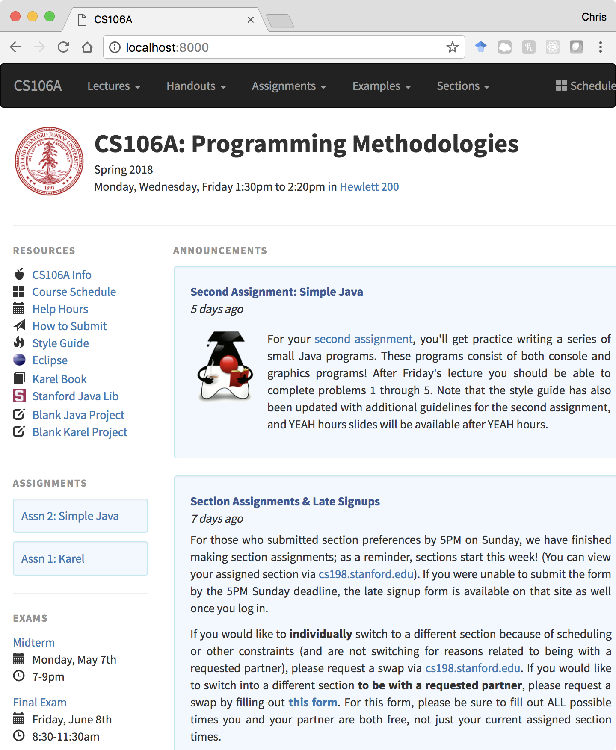
Graphics Variable Types

Slide 123
